Slide 1

NewMoms
Personal pregnancy data analytics app
for postpartum depression
Notes:
HI EVERYONE OUR PRODUCT IS CALLED NEW MOMS AND WE’RE EXCITED TO PITCH YOU OUR SOLUTION TO REACH WOMEN AT RISK FOR POSTPARTUM DEPRESSION IN LOW INCOME AREAS
The need- Alex
Ethical/health
Ppl affected
Social predisposition
Market- Alex N
How much does PPD cost society
$7,200 per mom
Competitive landscape
https://www.ncbi.nlm.nih.gov/pmc/articles/PMC5650672/
The app- Stephanie
So why an app?
Accessibility
Cell phone penetration
Incentive
Future directions - what do we need to do to make the app
Funding pathways
Ethical/health stats
Cost to the system
Why an app/The idea
The funding pathways
Why fund us (social determinants, cost of PPD)

Slide 2

Postpartum Depression
Notes:
PPD is a mental health illness experienced by women after childbirth. We recently heard a story about a young mother named Elaine who had her baby at 20 years old. The stress of having an unplanned baby, financial concerns, and her inability to breastfeed caused her to have severe anxiety and difficulties bonding with her baby. Elaine never even considered that she had PPD and after months of always being angry and sad she finally saw a doctor and received the help she needed. It is very good that Elaine saw a doctor because if PPD is left untreated, mothers are at risk of suffering chronic and recurrent depression throughout their life and unfortunately this can lead to suicide.
PPD is a mental health illness experienced by women after childbirth. Some symptoms include anxiety, mothers experiencing difficulty bonding with their baby, and a constant depressed mood. Women who experience PPD without receiving proper treatment are at risk of suffering chronic and recurrent depression throughout their life and unfortunately this can lead to suicide. PPD not only affects the mother, but can also lead to a weak maternal-infant attachment that may affect the child’s emotional behavior and cognitive skills.

Slide 3


1 in 7 women will experience postpartum depression
1 in 4 women of low socioeconomic status will experience postpartum depression
Source: AMHCA
Notes:
Postpartum depression, also known as PPD, affects 1 in 7 woman in the US but in lower socioeconomic areas 1 in 4 women are affected. This is a large population that is often left unaddressed and we plan to make an impact here.
900,000 women suffer from postpartum depression annually in the US

Slide 4
NewMoms
Improved Access to Clinical and Mental Health Resources for Postpartum Women
Notes:
NewMoms is an app that improves access to clinical and mental health resources for postpartum women.

Slide 5
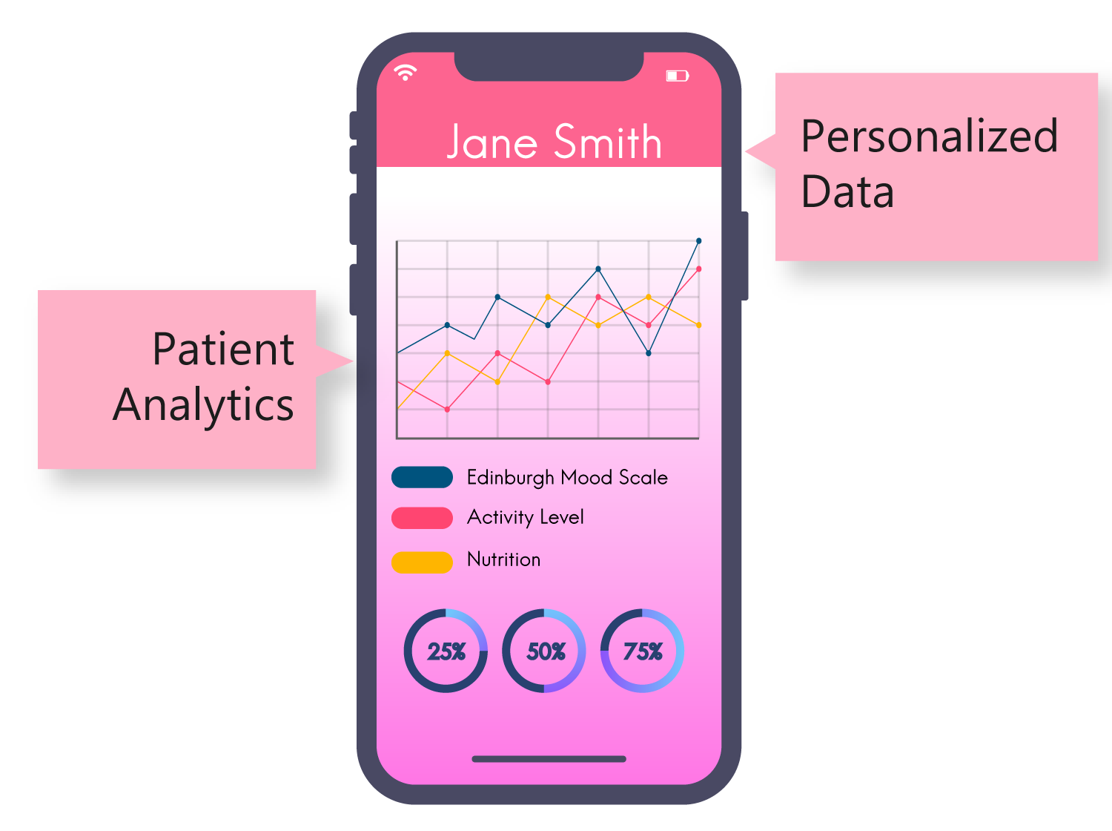
Data Visualization
Simple
Easy-to-use
Health Graphics
Notes:
It provides a system to consistently track pregnant and postpartum women's mental state via a short 3 question survey based on the recognized gold standard screening test every few days. The app’s goal is regular data collection, shown in an easy to read visual interface that allows users to see their mental state in a linear, visual representation so that they can easily detect changes and potential incidence of postpartum depression. This way, if a woman’s mental health state falls below a certain level, we can suggest that they see a clinician.

Slide 6

Partnering Manufacturers
Notes:
The app will implement an incentive structure using gamification in which consistent usage rewards the user with coupons for childcare products. For example, if the mother completes the depression screening test three times in a week, she could receive a coupon for $10 off Pampers diapers. Potential partners that we could work with include sponsor companies such as Johnson and Johnson, P&G, and Unilever

Slide 7
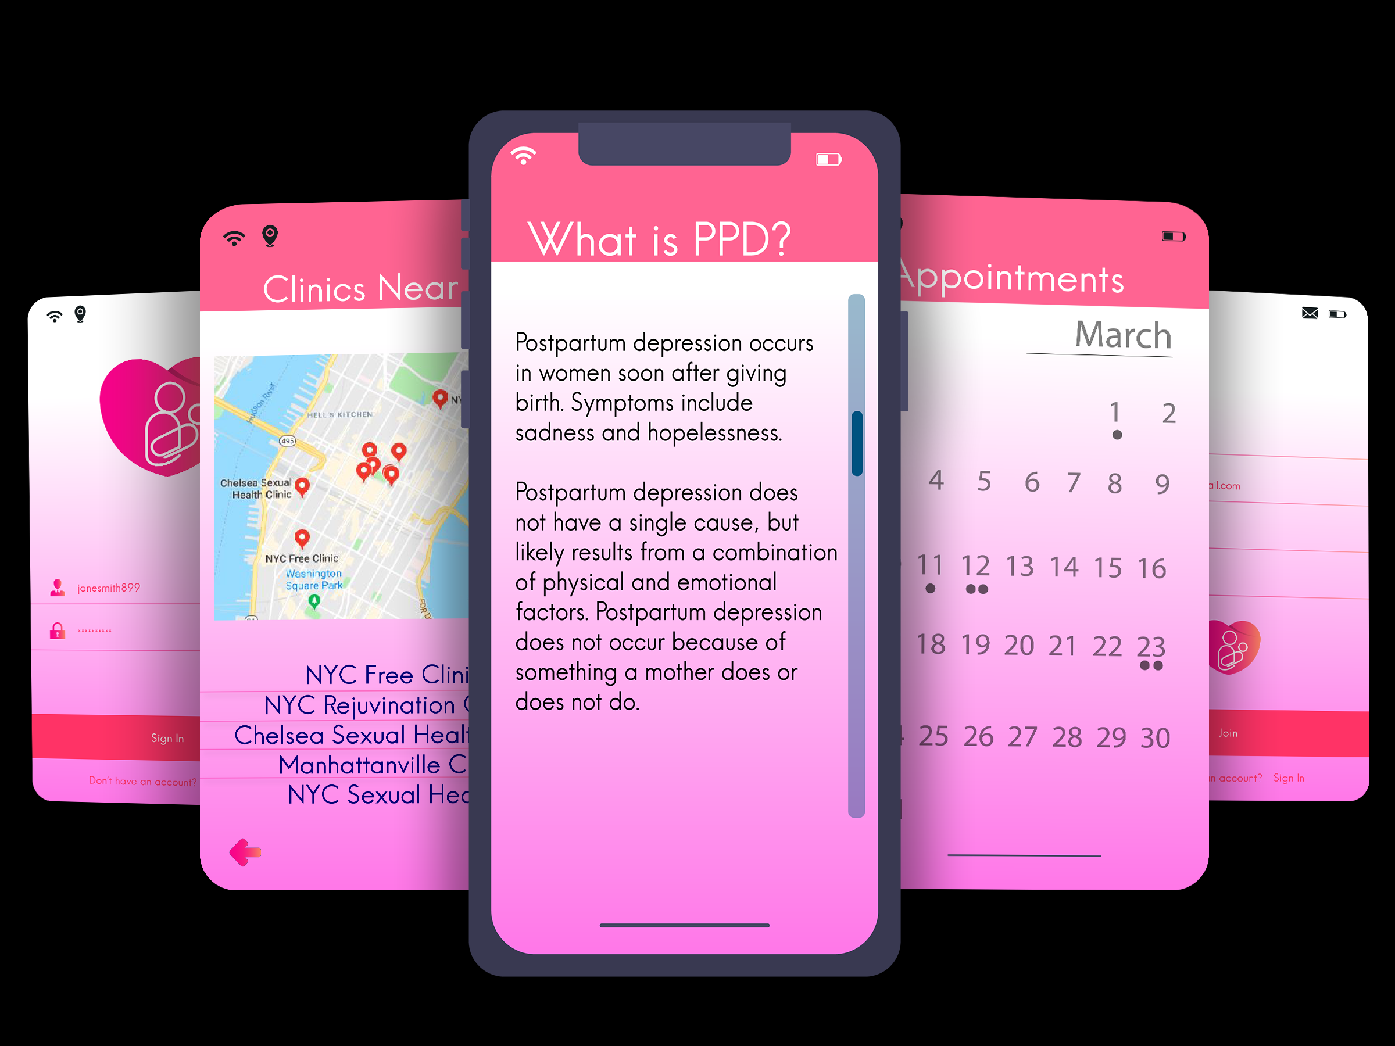
Additional features
Notes:
Other app features include resources with mental health and postpartum health information, a clinic referral system, and an appointment tracker.
These features would serve to provide educational services about mental and postpartum health, especially to new mothers. A clinic referral system would guide mothers to experienced and caring physicians at participating healthcare providers. Finally, an appointment tracker will notify women on when they should go to receive medical attention.

Slide 8
Impact
Accessibility
Personalized
Care
Incentive
Notes:
This app WILL improve accessibility for low-income mothers. We have found recent studies that have shown a continuing increase in low income individuals who are using smartphones. We aim to take advantage of this trend.
The app seeks to combine many resources into a single easy-to-use medium. Therefore, our proposed solution not only aims to raise awareness about PPD but also remain focused on personalized care to our at-risk population.

Slide 9
$5.7 billion
Annually for untreated maternal depression
Source: AMHCA
Notes:
According to the American Mental Health Counselors Association, PPD costs $5.7 billion in lost income and productivity in the US. This lost productivity has a significant impact on mothers who are trying to provide for their families, especially in low-income settings.

Slide 10

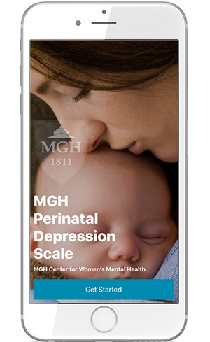
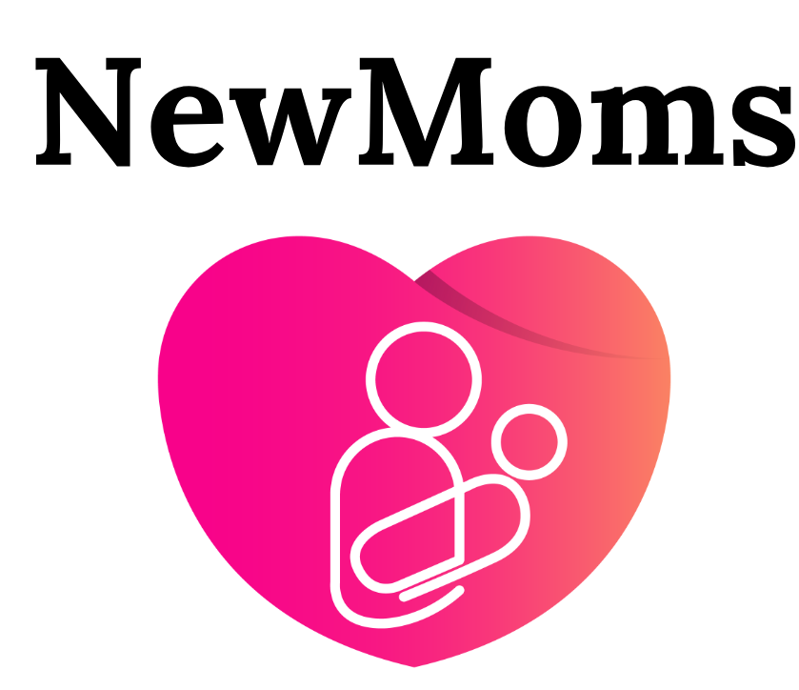
Competitive Intelligence
Gamification
Data Visualization
Accessibility
Notes:
When we investigated the competitive landscape around this technology, one app stood out as a potential competitor. MGH PDS screens for PPD through in-app questionnaires. Should you consent, the data can then be sent to your in-network provider. Our platform would be accessible to anyone, regardless of insurance or health group affiliation, and would provide the patient an easy to understand visual way to gage their data. Additionally we would be encouraging users to log data through coupon incentives

Slide 11




Future Direction
Market Research
Funding Campaign
Revenue Streams
Notes:
Future steps in understanding if NewMoms will be a viable product is to conduct primary and secondary market research. The voice of customer analysis would focus around rural communities since a main goal of the app is to increase accessibility to care for new mothers. Since the app would have a relatively low cost footprint, we plan to take on an altruistic funding campaign, targeting angel investors and Non-Governmental Organizations such as Merck for Mothers. This initial funding would aid in growing a significant user base. The next step would be to pursue partnerships with manufacturers like Proctor and Gamble, or Johnson&Johnson for ads and coupons which would provide sustainable revenue for general app maintenance. In conclusion, NEWMOMS will be a tool where women can view their changing mental state in order to recognize downward trends before they become severe.

Slide 12
Improved Access to Clinical and Mental Health Resources for Postpartum Women
Thank you!

